Slide 1

SCIENT INSTITUTE OF TECHNOLOGY
APPROVED BY AICTE, and AFFILIATED WITH JNTU HYDERABAD
(Ibrahimpatnam,R.R.Dist,Telangana, 501508. ESTD:2001)
2024-2025
TITLE:Analyzing Flight Delay Trends, Causes, Frequency, and Their Impact on Passenger Experience and Airline Operation
UNDER THE GUIDANCE OF:
MR.SMD.SHAFIULLA
Assistant Professor
Dept of AI & ML
TEAM MEMBERS:
23C01A7304
23C01A7330
23C01A7339

Slide 2
Contents
Abstract
Introduction
Existing System
Proposed System
Module description
System Requirements
Architecture
Algorithm
Testing
Results / Outputs
Conclusion
Future Scope

Slide 3
Abstract
Flight delays are becoming more common because of increased air traffic, bad weather, and crowded airports. These delays cause problems for passengers, like missing connecting flights, spending extra money, and feeling stressed. Airlines also suffer - they spend more on fuel, staff, and maintenance, especially when using older, less efficient planes. Delays can also harm their reputation. Busy routes and peak travel seasons often see more delays, and problems at major hub airports can affect many other flights. In the end, delays hurt both the quality of service and the profits of the aviation industry.

Slide 4
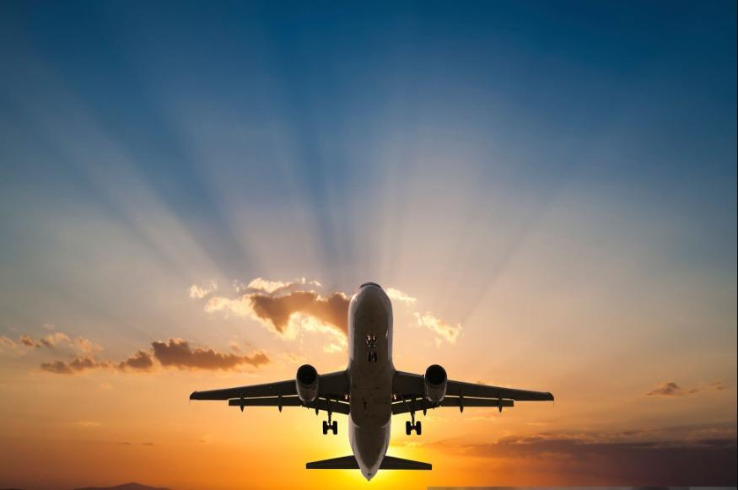
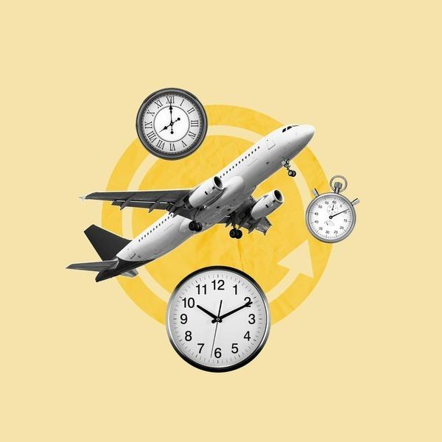
INTRODUCTION
Delay Frequency
The Data about how often flights are late and what problems they cause
Economic Costs
How flight delays cause problems for airlines and passengers
Environmental Impact
Delays make planes use more fuel and pollute more
Study Goals
Find out what delays do and ways to reduce them.

Slide 5
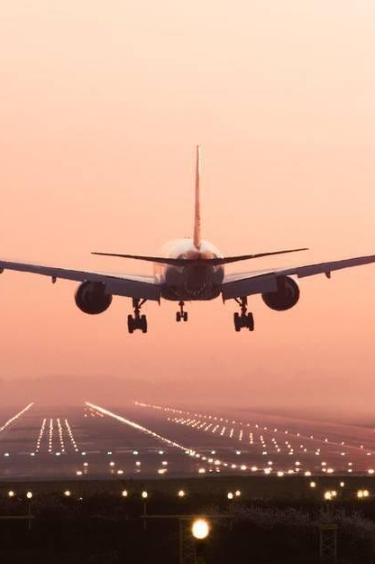
PROPOSED SYSTEM
Prediction
Use past delay information to guess how ticket prices will change
Route Analysis
Compare flights that go through big airports (hubs) with flights that fly straight from one city to another (point-to-point)
Market Variables
Market variables are things that affect prices and demand, like how many people want to fly, special events, or holidays.

Slide 6
Module description
Pandas
A tool to organize and analyze data in tables.
Matplotlib
A library to create basic charts and graphs.
Seaborn
Makes colorful and attractive statistical graphs easily.
NumPy
Helps work with numbers and do fast math on lists of data.

Slide 7
SYSTEM REQUIREMENT
Hardware
Software
Python
8 GB RAM
i3 or higher processor
Notepad or VS Code
Windows OS
Excel/CSV datasets
500 GB HDD

Slide 8
Architecture
[User] → [Web Browser]
↓
[Upload CSV File]
↓
[Process Data]
↓
[Generate Report]
↓
[Display Results]
↓
[Save Data as CSV]

Slide 9
Algorithm
Data Preprocessing Algorithm
Input: Flight data CSV
Process: Remove empty values
Output: Clean data ready for analysis
Delay Analysis Algorithm
Input: Clean flight data
Process: Count delays by airline and status
Output: Charts showing delay patterns
Flight Filtering Algorithm
Input: Flight number from user
Process: Find matching flights
Output: Report for specific flight

Slide 10
TESTING
Test Category | Test Cases | Status
Data Input Tests | Valid CSV upload, invalid format rejection, empty file handling | PASSED
Processing Tests | Null value removal, Only bad data gets removed | PASSED
Reporting Tests | Report accuracy, status-based, flight filtering | PASSED
Interface Tests | File upload functionality,navigation paths | PASSED
Error Handling Tests | Error messages, stability with invalid inputs | PASSED

Slide 11
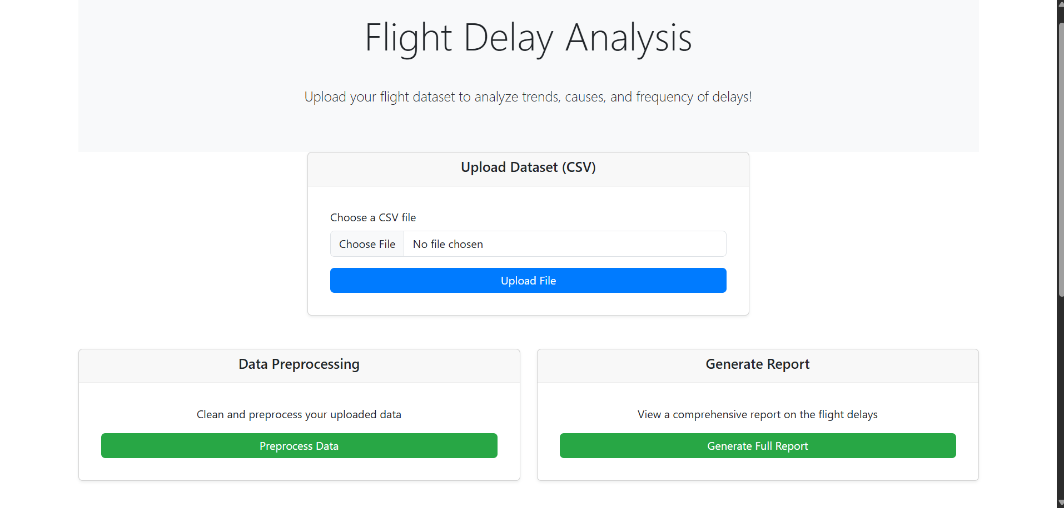
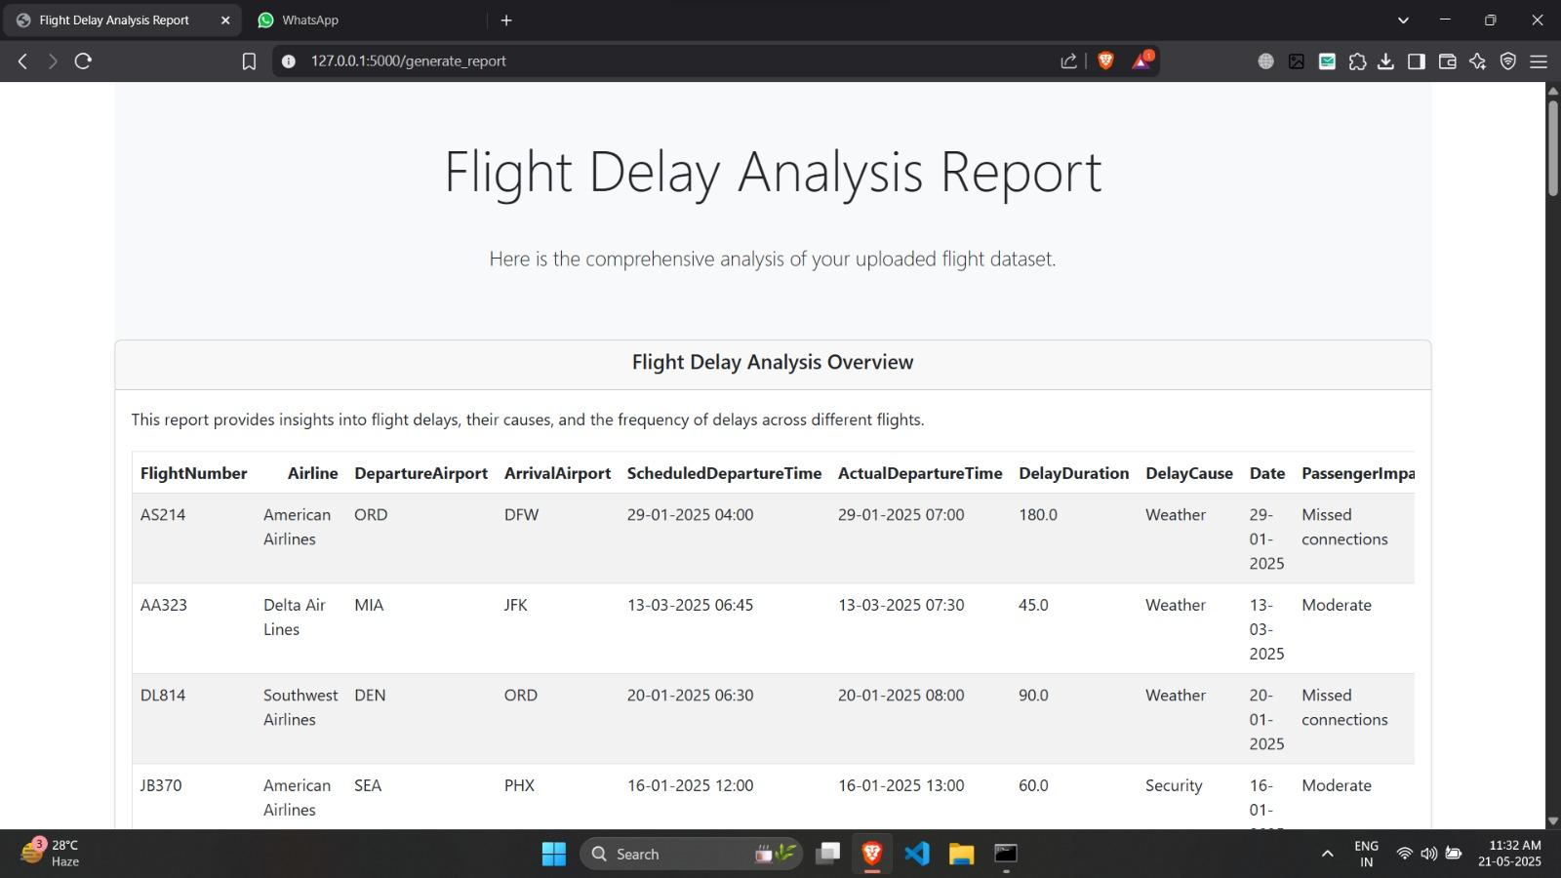
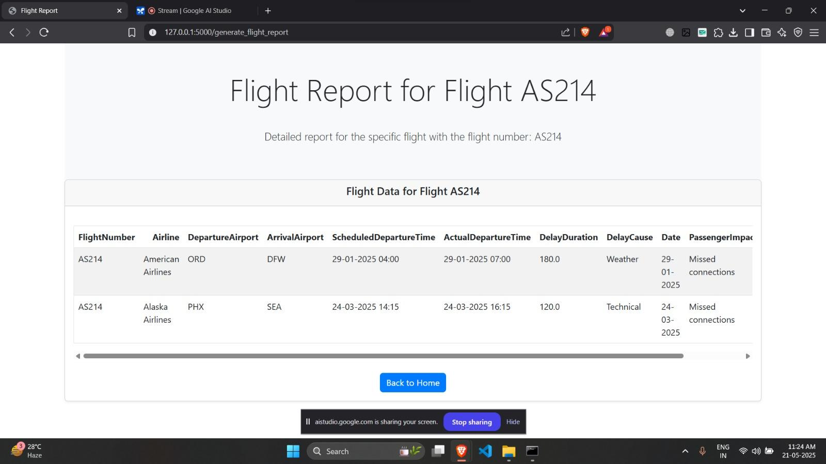
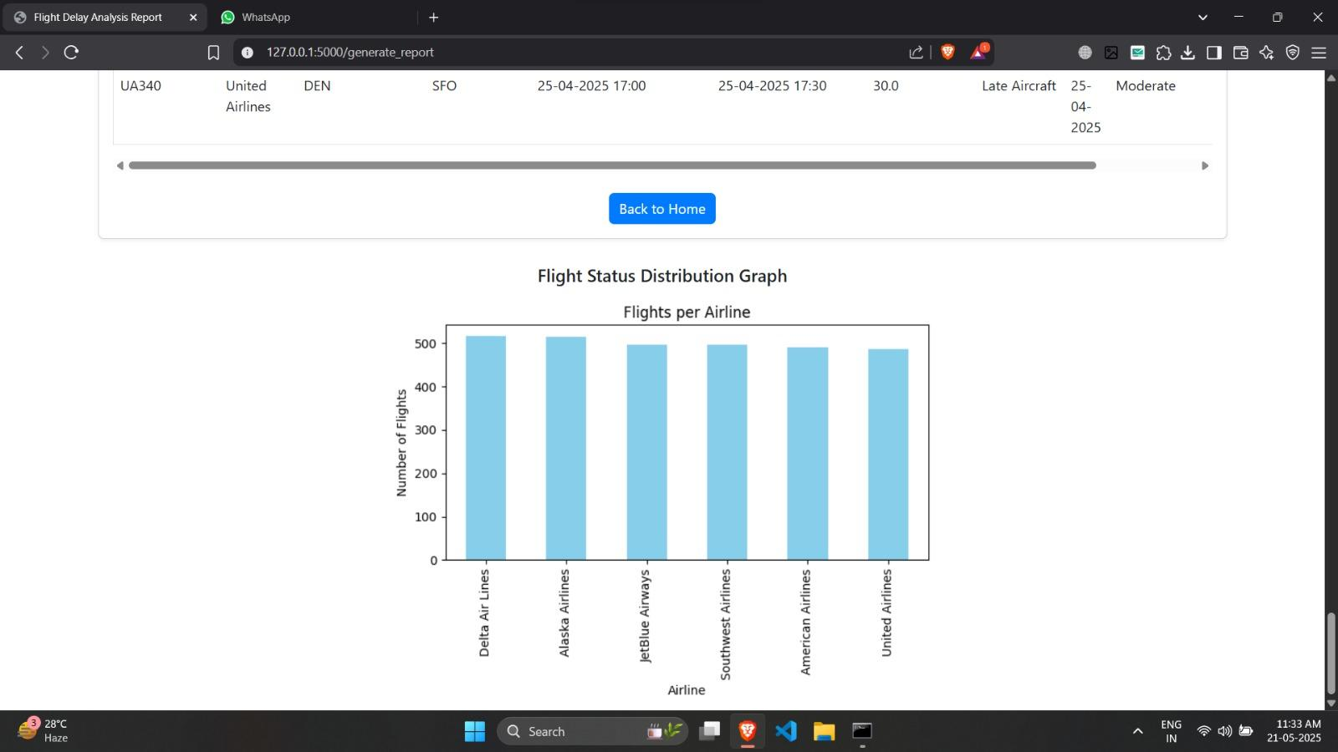
Results/Outputs

Slide 12
Conclusion
For airlines, delays can mean more money spent on fuel, staff overtime, and airport fees. For passengers, delays cause stress, missed connections, and wasted time. It can also affect people’s work, family plans, or vacations.
This project studies how airlines deal with delays. For example, they might change ticket prices or reschedule flights, especially on busy routes where many people travel.
We also look at things that affect these choices, like fuel prices and whether a flight goes through a big hub airport or is a direct point-to-point flight.
By looking at past delay data, this project helps us understand how airlines can plan better in the future. This can lead to fewer delays and a better experience for travelers.

Slide 13
FUTURE SCOPE
Improve Delay Predictions
Use real-time data and AI to predict flight delays more accurately.
Help Airlines & Passengers
Support better scheduling, pricing, and smoother travel experiences.
Create Useful Tools
Develop apps or websites to share delay info with passengers and airport authorities.

Slide 14


